Slide 1



Supply Chain and Inventory Management
Data Analysis Specialist Track – Graduation Project

Slide 2





The Team
As a team, we were fortunate to have a diverse set of skills. Each team member had experience with two or more of the tools we used. Everyone contributed valuable insights through research into key aspects of supply chain and inventory management. We were lucky to have such a well-rounded team.
Sameh El-Araby
Marian Youssef
Reem Nasr
Mary Magdy
Aya Ayman

Slide 3
Summary Goals and Objectives

Slide 4
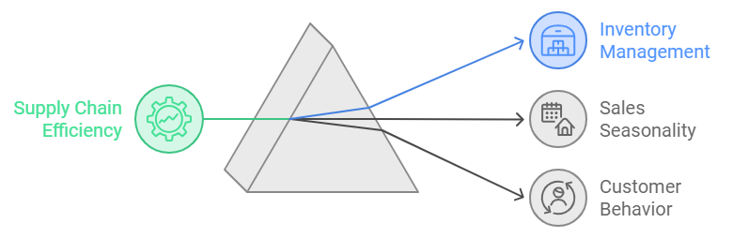
Summary
Goals
Our project focuses on supply chain and inventory management. We’re analyzing sales, inventory, and stock data, for an international e-commerce platform.
Our main goals are to use data-driven insights to improve these processes, track trends, and demonstrate how different factors like sales seasonality, customer behavior and inventory levels affect their supply chain and inventory management performance.
Objectives
Supply Chain and inventory Efficiency and profitability.

Slide 5
The Dataset
Data Analysis Specialist Track – Graduation Project

Slide 6
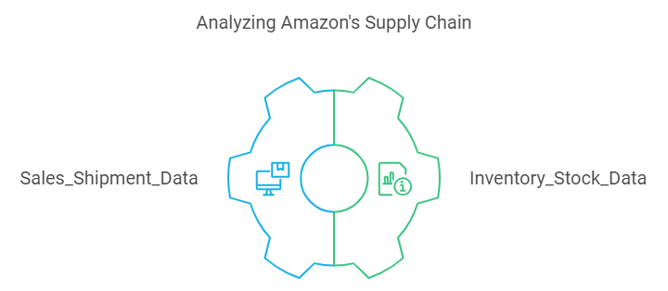

The Dataset from
Note
Factors we considered while choosing the data set to work on:
Large data
Not AI-generated
Real data, not clean.
A Dataset of Supply Chains used by Amazon will be used for the analysis.
Which allows the use of Exploratory Data Analysis, Predictive modeling Algorithms using python, SQL and Excel.
As part of this Project, we are using two datasets (Sales_Shipment_Data) & (Inventory_Stock_Data) as CSV files to answer different business questions.

Slide 7
Data Exploration

Slide 8
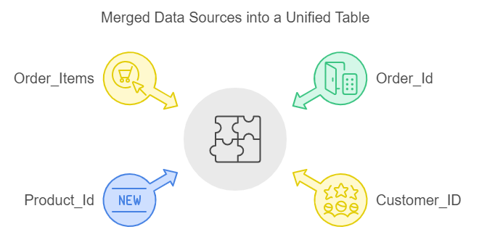
Initially, we all explored the data using Excel. Then, we checked for data types, unique values and redundancies using Python. Noticed that the table: 'Sales and Shipping Data' was a merged table from multiple sources. The first step we took was to normalize the data by checking for redundancies and duplicates in the columns, which helped us identify how many separate tables were combined.

Slide 9
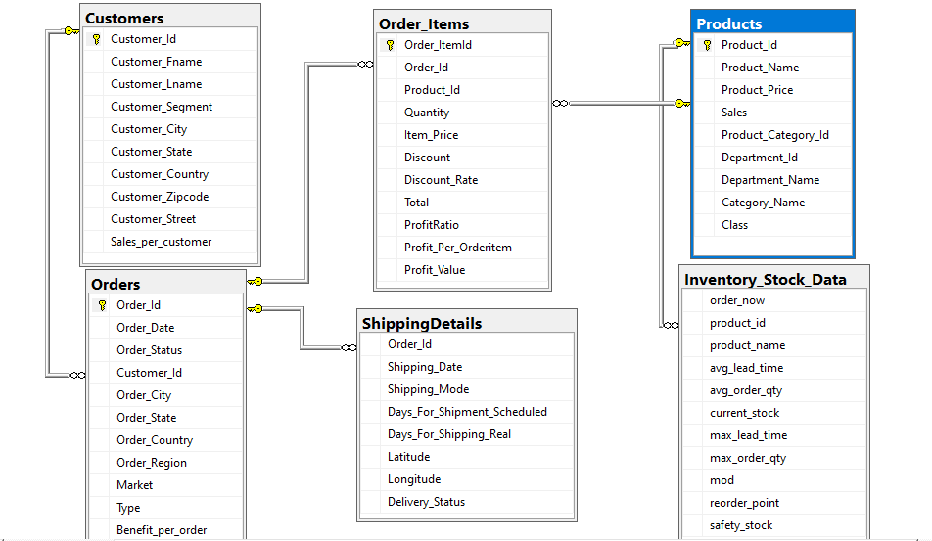

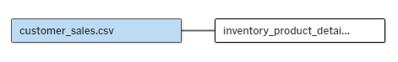
Database Diagram or ERD.
We then created 2 views on SQL to be used on “Python” and to be imported on “Tableau” as well.

Slide 10
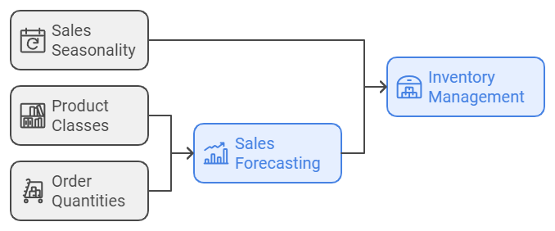
The main aspects in the dataset that affect supply chain and inventory management.
The product classes represent their value vs. their quantity.
Some products are premium ones with high value and high profit impact, others are of lower value but being ordered the most.

Slide 11
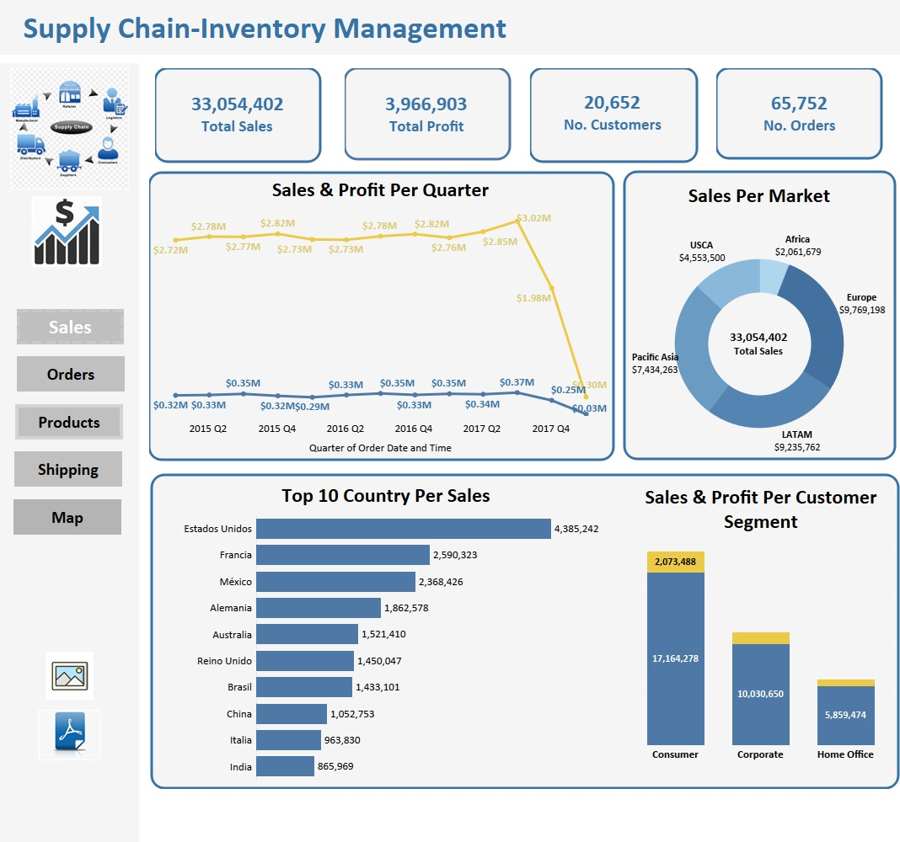
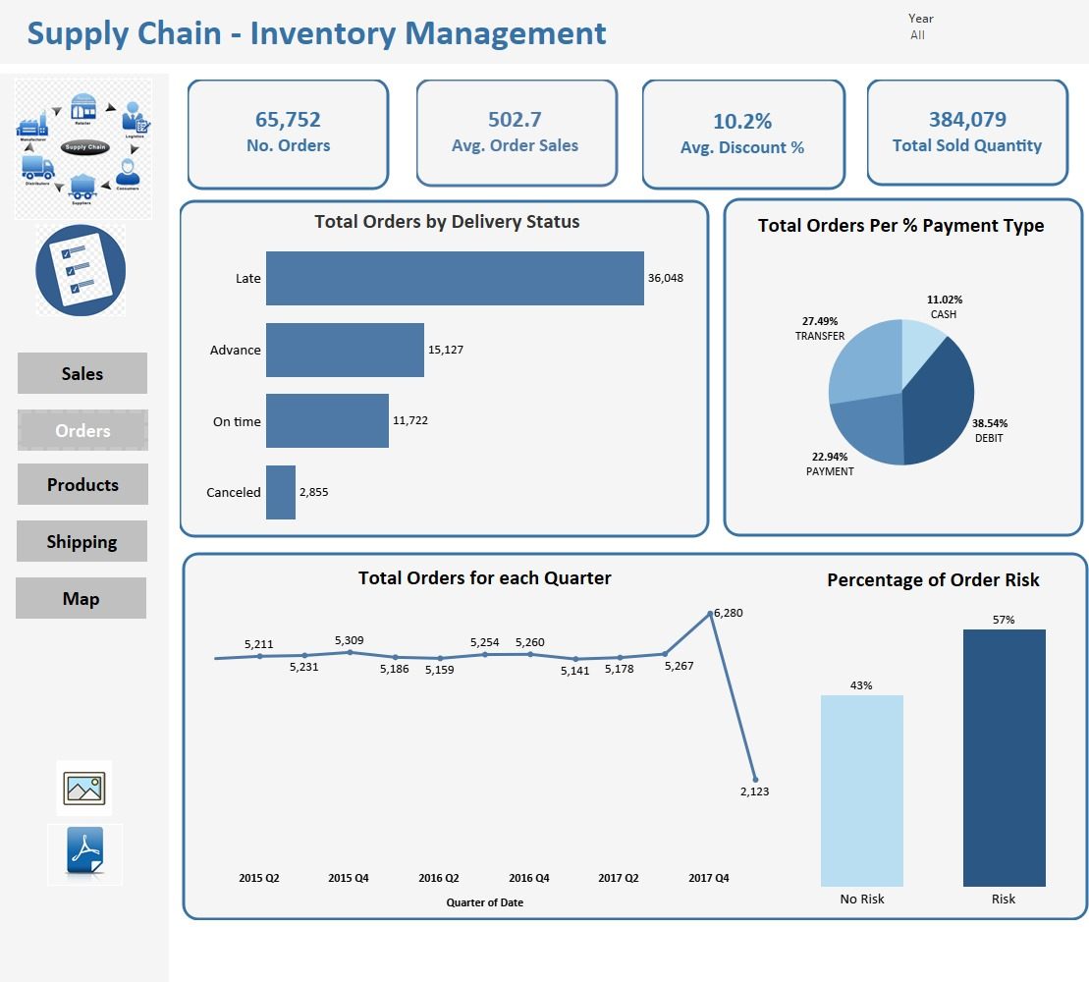

Slide 12
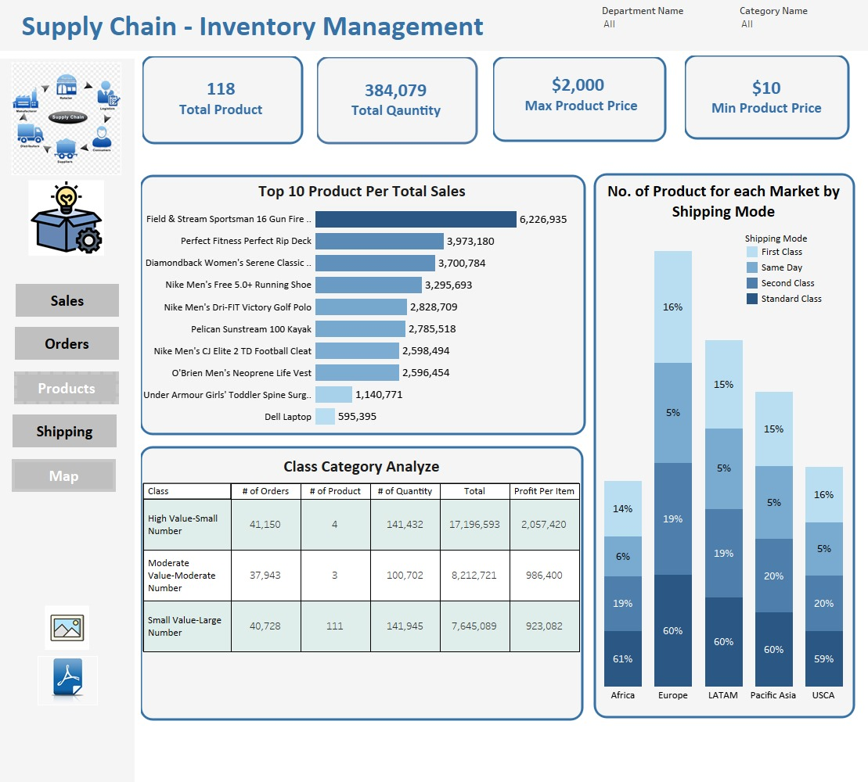
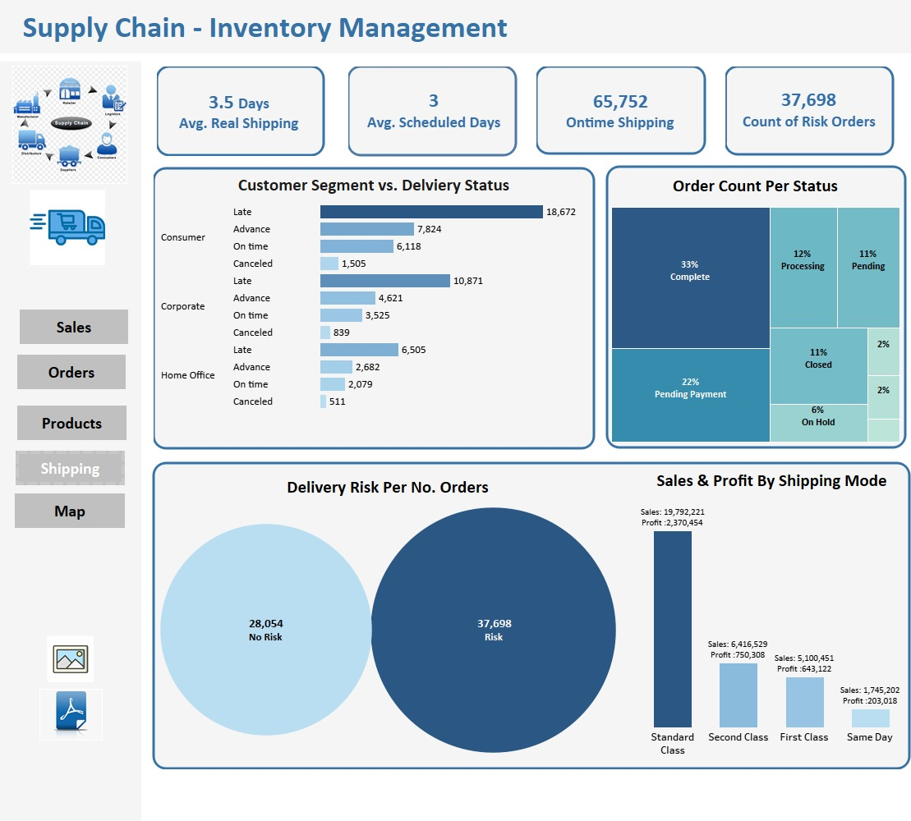

Slide 13
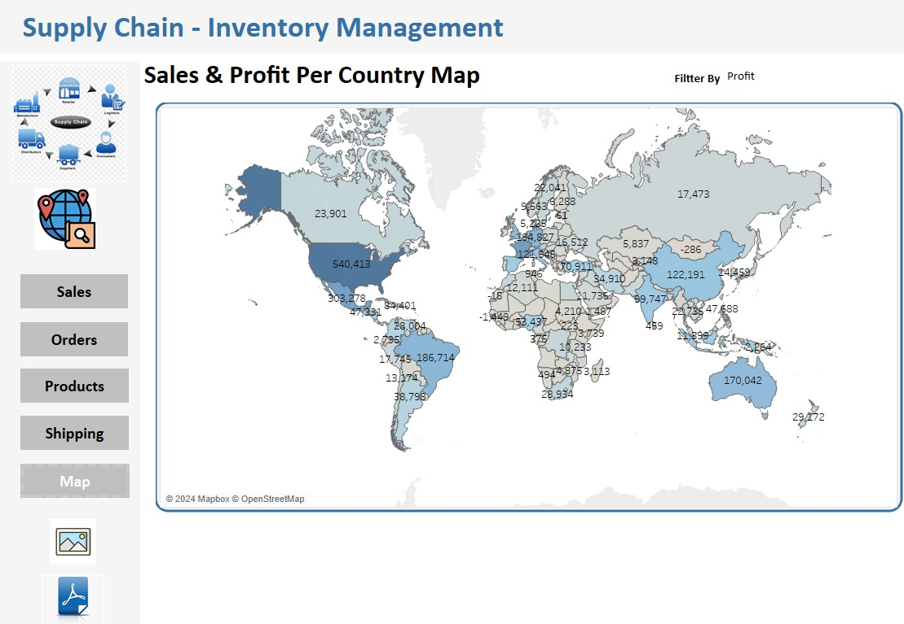

Slide 14
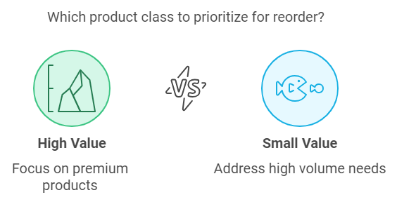

Slide 15
Thank You

